Slide 1

iCub
maintenance!
training ep.1
Notes:
Goodmorning everybody, today me and Paolo Uboldi will talk about the main activities for iCub maintenace and support. We will go through two examples of daily fixes and we will try to summarize the main steps in this first short episode.

Slide 2
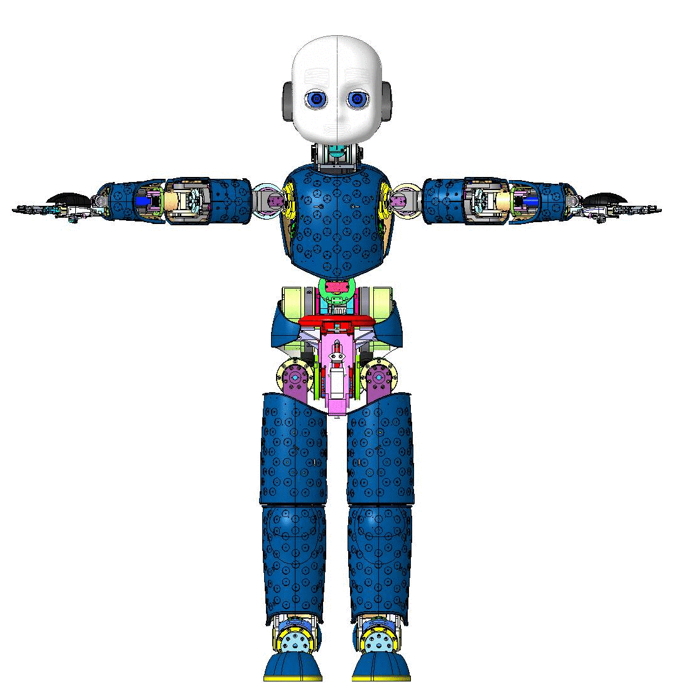
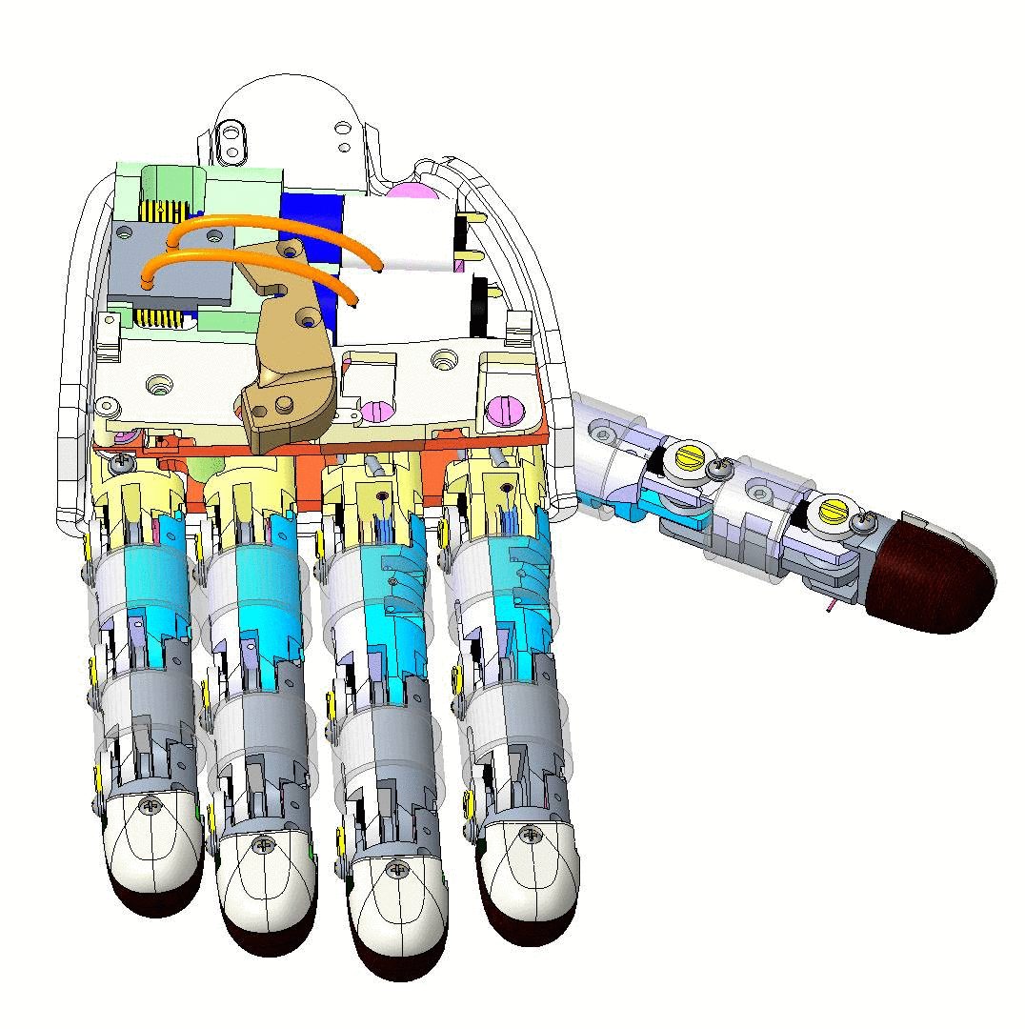




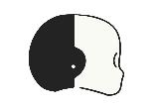

Course outline
1
2
3
4
5
About us
Activities and tools
Examples
Resources
Conclusions
Notes:
Those are the main sections for today. We are part of the proto-team, which is responsible of maintenance and prototyping all the new iCub robots. Furthermore, we are responsible for renovation of the old robots (upgrade kits). We will talk about our main activities and the tools we use everyday. Next we will introduce two pratical and common examples for a distal joint and a fingertip replacement.
Least but not last, the documentation and the resources will be reported.

Slide 3

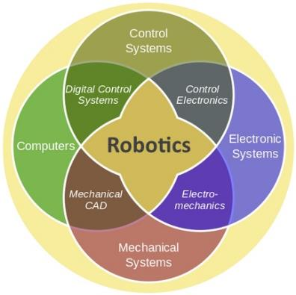
About us
Our mission
Provide support to research lines and maintain all iCubs we produce in an optimal state
We are a multidisciplinary team that loves to get our hands dirty and fix things!
Our expertise
Thanks to our experience we could see with our own eyes the most common problems with iCub, and for this reason an extensive support network has been created for all models in the world.
Notes:
When we deal with robotics , especially iCub, we need to engage sometimes with very different problems (mechanics, electronics, control systems and so on...).
Our mission is to maintain alla the iCub platforms in a optimal state and to prevent future issues.
Thanks to our experience we know how to deal with common issues with this robots and for this reason an extensive support network was created for all the iCub around the world.

Slide 4
Before we begin, one thing to always remember....
?
Notes:
But ... Just before starting, we must remember one thing...

Slide 5
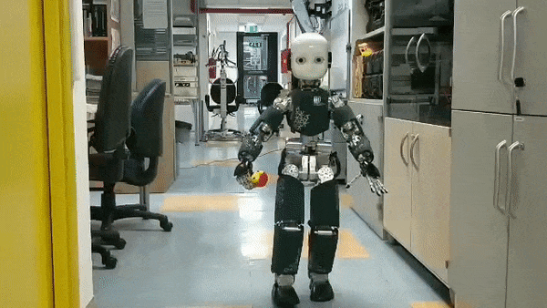
“If something can go wrong, it will”
— Murphy’s law
Why?
How?
What's broken?
Understand, fix and prevent!
Notes:
“If something can go wrong, it will”.
As you can see from this slide and from the short video, when something happen with iCub it is necessary to understand:
1.why it happened
2.How
3. And finally how to prevent it

Slide 6
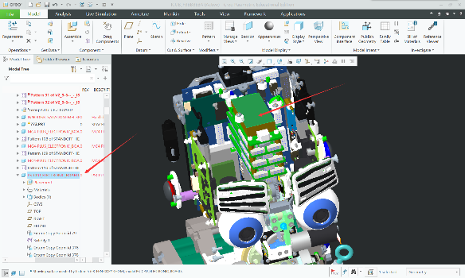
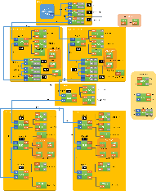

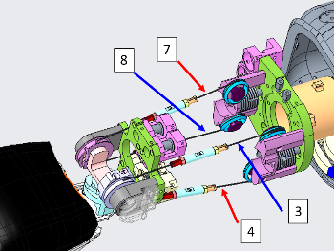
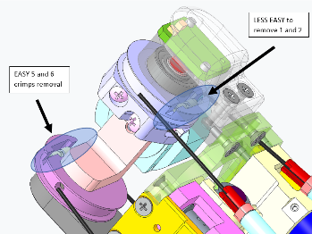



Activities and tools
Mechanics, electronics or even the control software
Mechanics
Among the most common problems we have the breakage of tendons for the movement of the joints, DC motors to be replaced or breakage of the external covers.
Electronics
iCub uses many boards and sensors that must coordinate very well, and sometimes you might run into errors or connectors that need to be repaired.
Software
YARP is the middleware used for testing and debugging, and ad hoc applications have been created to test the different sensors and control modes.
Notes:
Problems can be at different level, for example with the mechanics, electronics or software compatibility between new release and old haerdware setup.
For example, the most common issue for the mechanics is the breakege of the tendons and this is very time-consuming in order to fix it.
What about the electronics? There are so many board which need to coordinate in a perfect way, and sometimes just a little wire (CAN lines or ethernet) could cause the fault of the system.
In order the find and track the problem we can use different applications like the yarpmotorgui, that can show to you which is the incriminited joint.

Slide 7
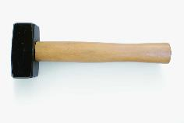
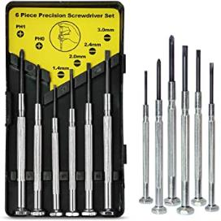
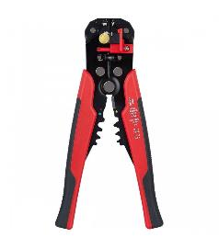
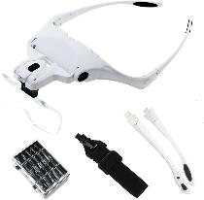
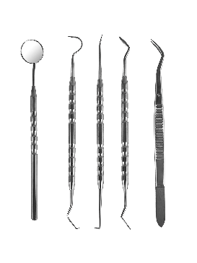
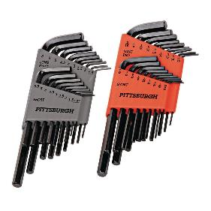
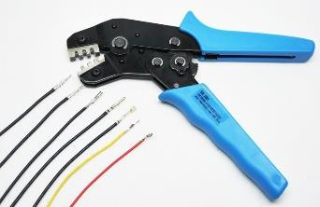
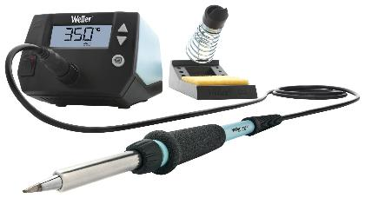
TOOLS
There are some very useful tools to have for proper maintenance
!
crimper
This should be used wisely and only as a last resort!
magnifying glasses
screwdrivers
Metrical allen keys
dentist tools
wire stripper
soldering station
These can come in handy for tendons and very tight places
In general, the problems can be very different from each other, so it may be the case to have more kits available…
Notes:
With this slide we want to show you some of the most common tools used for daily iCub maintenance. For example screwdrivers kits, crimper, wire stripper, metrical allen key and for the electronics part we should have at least a soldering station and magnifying glasses.
In the top right corner you can find the most important tool when thing are going wrong (the hammer). Use it wisely!
A small suggestion is to have also a dentist toolkit (cheap) for thight holes or just for wiring.

Slide 8
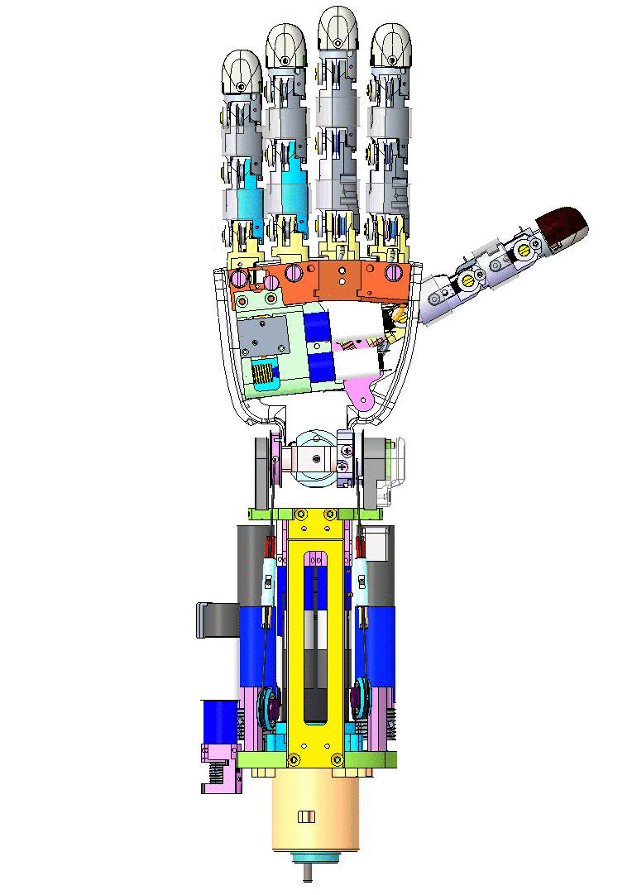
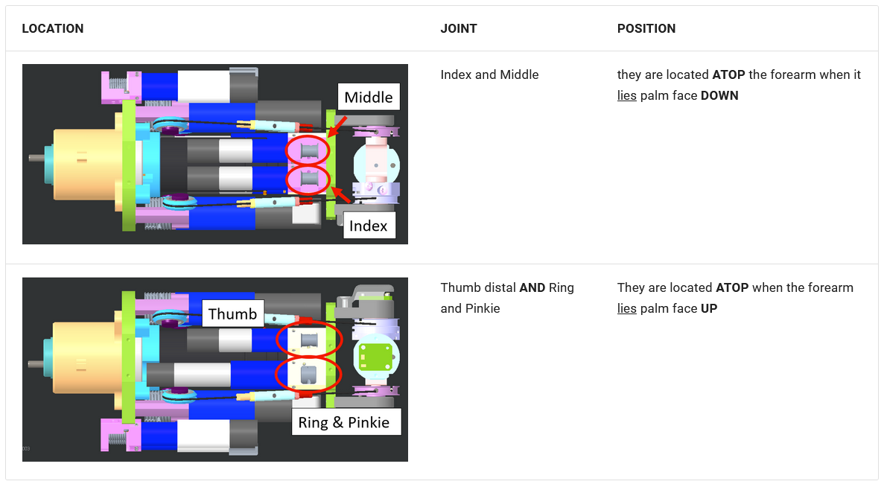
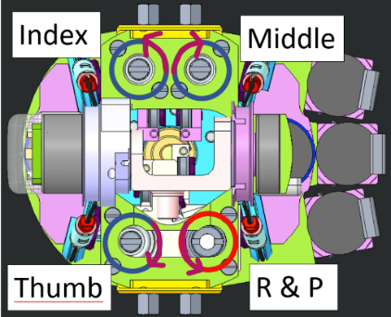
How do I locate the motor in which the cable broke?
Ex. #1
Index distal tendon broke
We will proceed by showing you how to re-cable both Index distal from the LEFT forearm
The arrow represents the sense of rotation to close the finger. It is important, after the cabling, to verify that the finger closes when the motor is rotated according to the respective arrow. You can rotate the motor with a flat screwdriver to do so.
DOCUMENTATION!
https://icub-tech-iit.github.io/documentation/icub_tendons/lower_arm_V2/#index-or-middle
Notes:
As first example we will show how to replace a broken tendon, in particular the distal index one.
The first step is to know where the corrispondent DC motor is located, and clean the area from the previous broken cable.
To be sure if you’re looking at the right motor, you can use a flat screwdriver and try carefully to rotate it.
But attention! As you can see from the picture on the right there is a correct sense of rotation if you want to close the finger and this must match with your hardware setup.

Slide 9
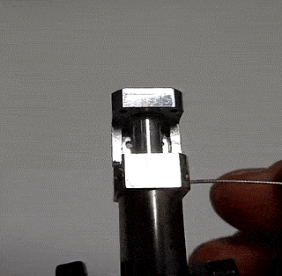
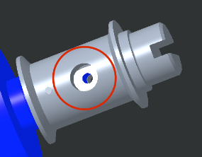
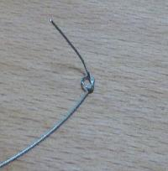
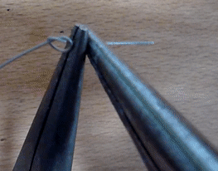
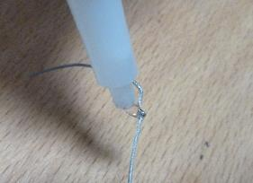
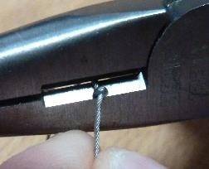
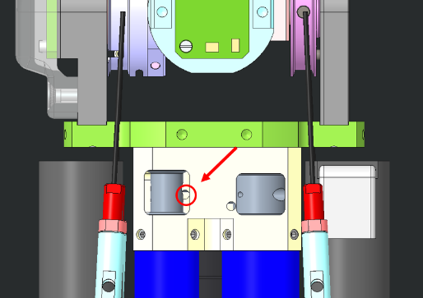
Knot creation
Wiring
Insert the knot until it remains inside the socket of the pulley
Just insert the cable inside the hole (red circle)
Start by cutting one piece of 40cm from the cable IITCODE 2391.
Make a knot at one extremity.
Small suggestion !
To facilitate the creation of the knot it is advisable to use pliers and a drop of glue (attack) to lock the knot.
Notes:
First step is to order the steel microcable (please refer to customer service for this details). Please note: we have two different cables to fix the hand joints (distal or proximal?)
Once you have the cable you must create a knot, and for this purpose you can use a little drop of glue to fix the knot.
After you made the knot, you should insert the other side of the cable into the pulley hole (the big one).
The wire must be inserted in the red circle as reported in the last picture in the bottom

Slide 10
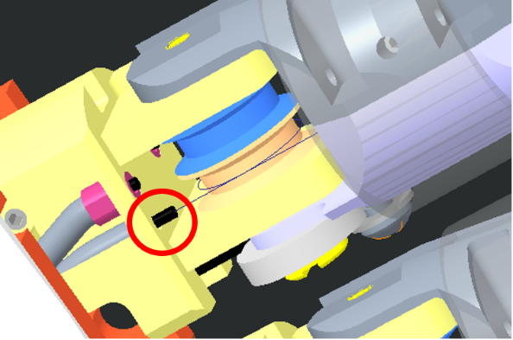
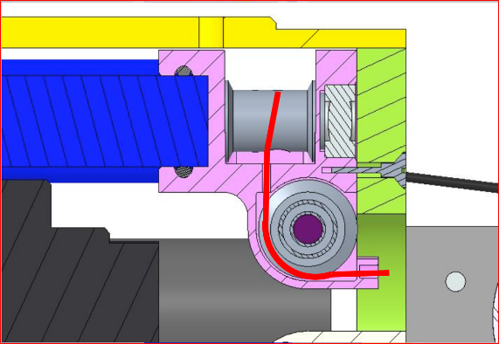
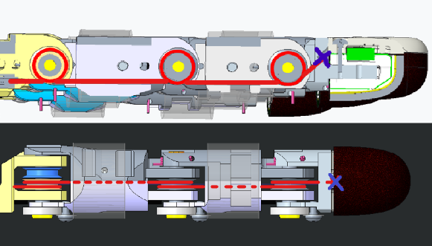
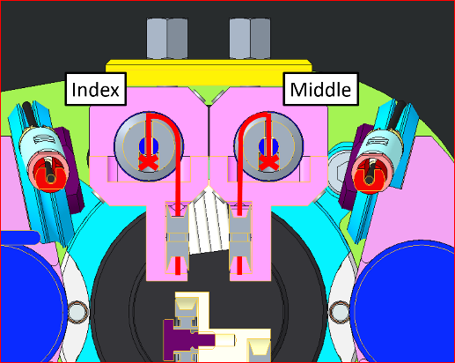
Wiring
4. The cable will then run inside the sheath until it reaches the base of the index
5. Wire this way.
3. The cable should get OUT from here - BE PATIENT!
Notes:
Now try to follow the sheath in order to find the right location for the cable. Be patient, because this step is a bit tricky.
The cable will then run inside through the sheath (sleeve) until it reach the base of the index.
Wire the cable by making one turn for each pulley as shown in the picture 5.
INSERIRE VIDEO??? O GIF??

Slide 11
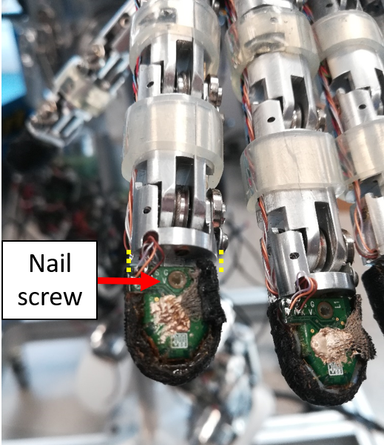
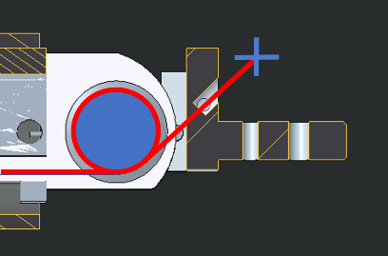
Wiring
6. Please remove the screw holding the nail onto the fingertip - move the fingertip sensor away from the base of the fingertip (1cm away max)
Last step!
7. Make the final knot - you need to make it very close to the finger nail hole (1-2cm away max)
Notes:
At the end you need to remove the nail to make the final knot.
For an optimal result and to avoid that the cable is too loose, you need to bend the finger and recover some length of wire (1-2cm).
Congratulation! You win ☺

Slide 12
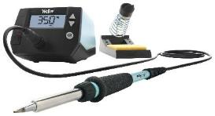

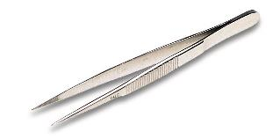
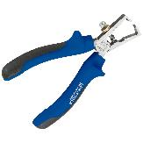
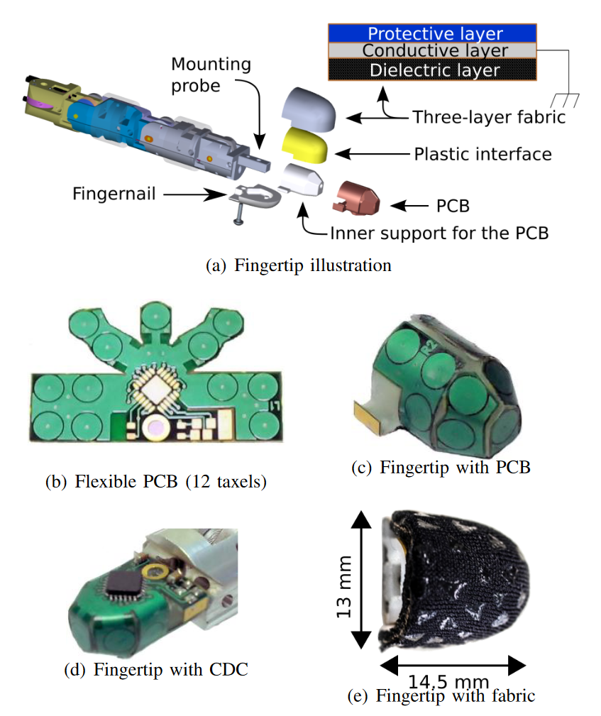
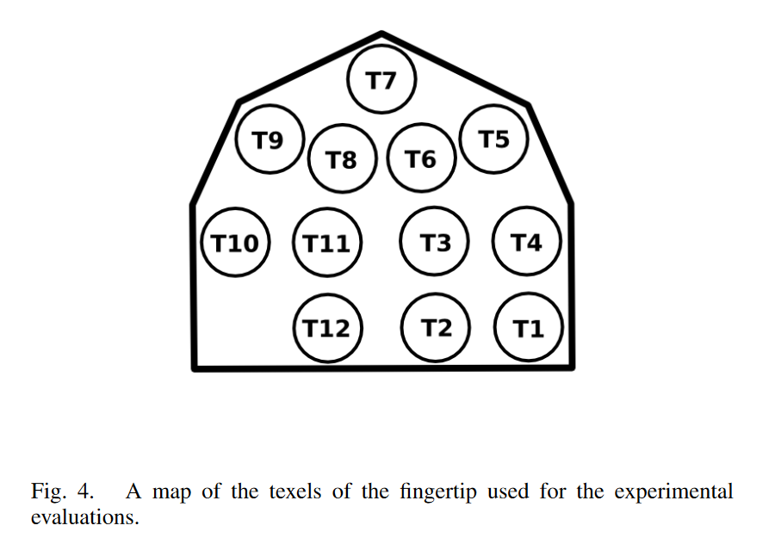
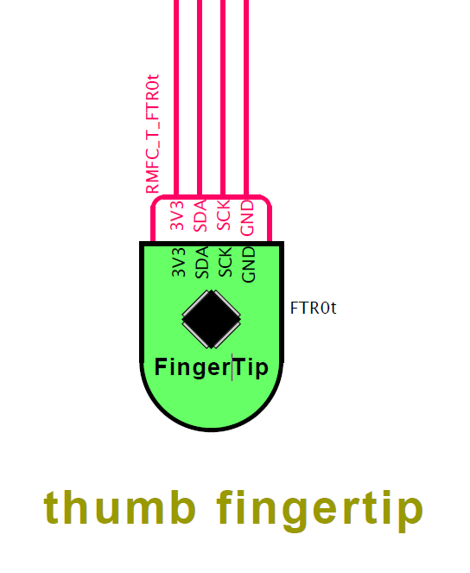
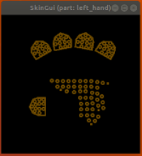
What do you need?
Ex. #2
Fingertip replacement
We will proceed by showing you how to replace a fingertip
The sensing elements of the fingertip are capacitive sensors made from a flexible PCB, and a multi-layer fabric that includes the dielectric material and the conductive layer.
Notes:
Now we will proceed with the second example. We will try to summarize the main steps for a fingertip replacement, and where to find the resources needed to do that.
From the picture on the left you can see how a sensorized fingertip is made and the sensor matrix realized with the flexible PCB.
To replace a fingertip you need at least a soldering station, wire stripper and a pair of pliers.

Slide 13
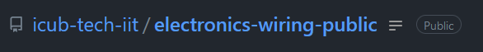
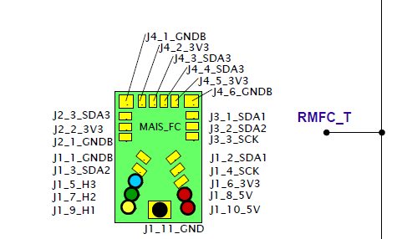
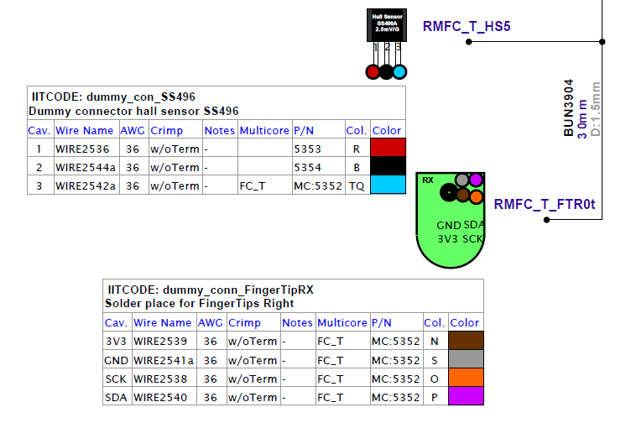
Schematics
Repository
There is a public repository that contains all the needed schematics.
You have to search for the exact version of iCub.
(example)
Notes:
All the schematics for wiring are available online from our repository: icub-tect-iit → electronics-wiring-public.
You must find the right version for your iCub model and open the pdf files. There are two different type of files, the harness and the logical one.
The harness is for what concern the electrical components and wiring details. Instead, inside the logical pdf file you can find all the hyerarchical relations between boards and sensors.

Slide 14
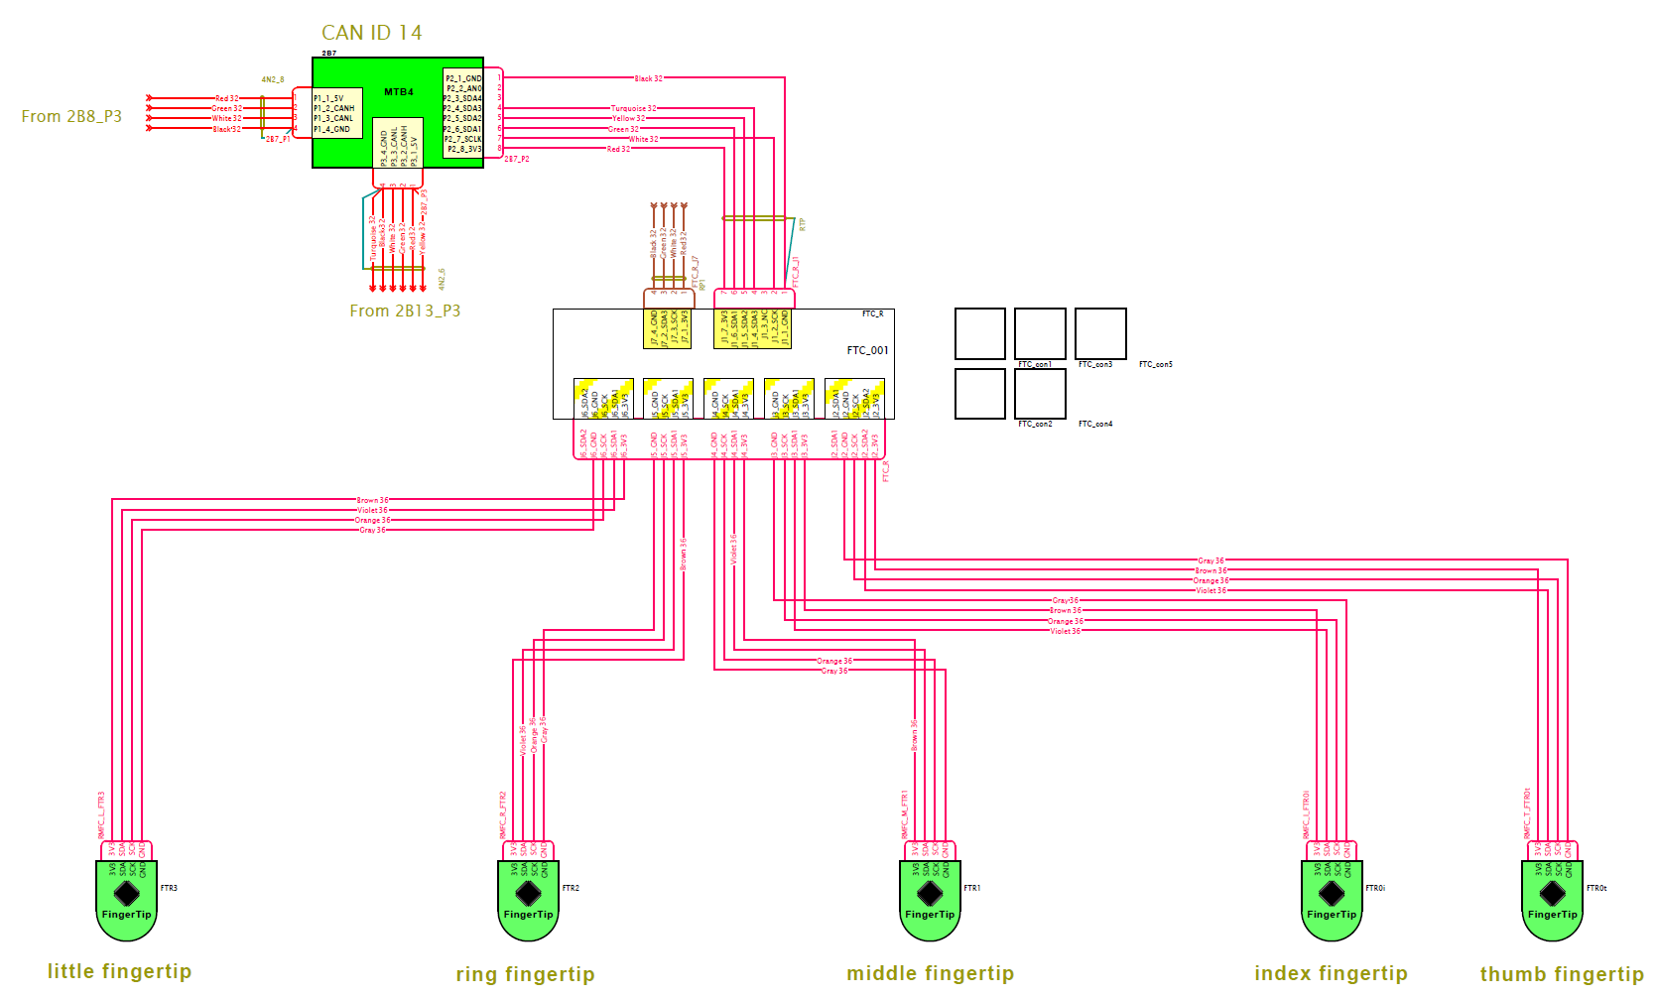
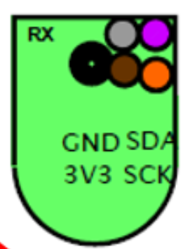
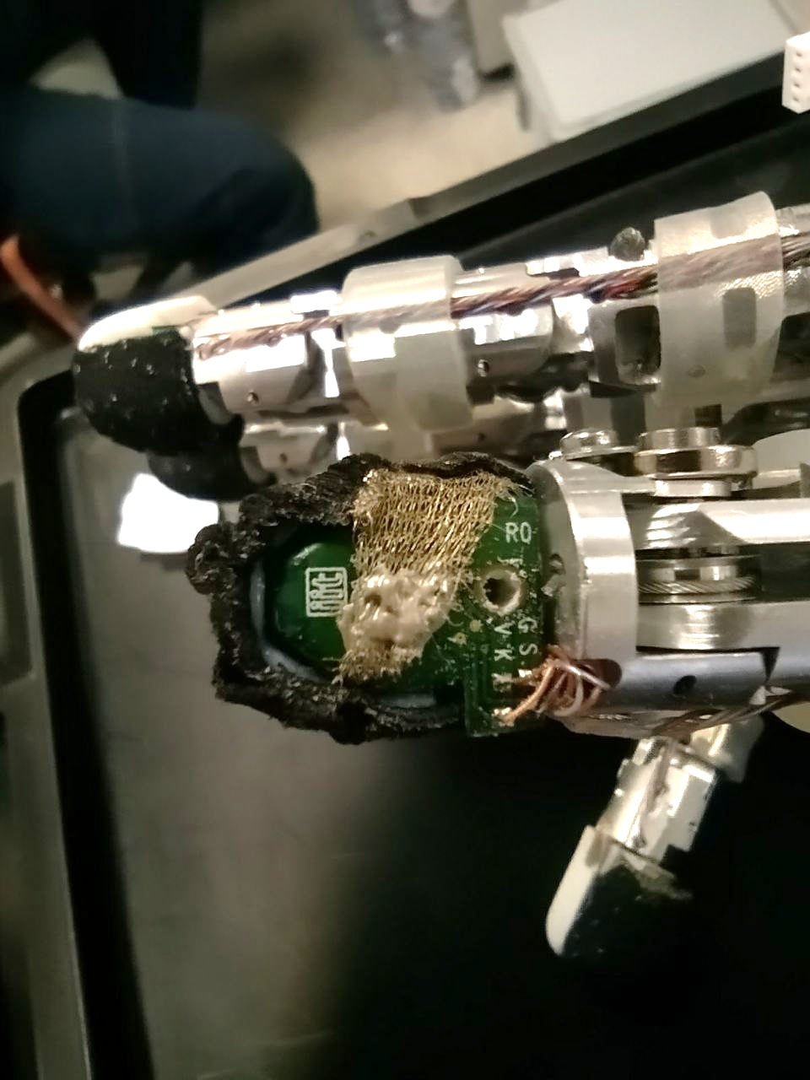
Wiring
Take a good look at the connections and compare with the actual hardware!
Very thin wires…
Once the new fingertip has been inserted, solder the 4 wires according to the legend in the schematic diagram.
Notes:
How to wire this fingertip? Go to harness pdf file for iCub 2.7 and search for R0 (thumb) fingertip. Look at the colors and the letters onto the fingertip and match those:
G – Grey
S – Violet
V – Brown
K – Orange
Solder and try to open the SkinGUI to see if the matrix is correctly configured.
NOTE: everytime you make an hardware change is a good pratice turn off the motors and restart the yarprobotinterface and the skinGUI.

Slide 15
Documentation and resources!
Notes:
Now, we will see where to find all this resources and tutorial for common issues.

Slide 16
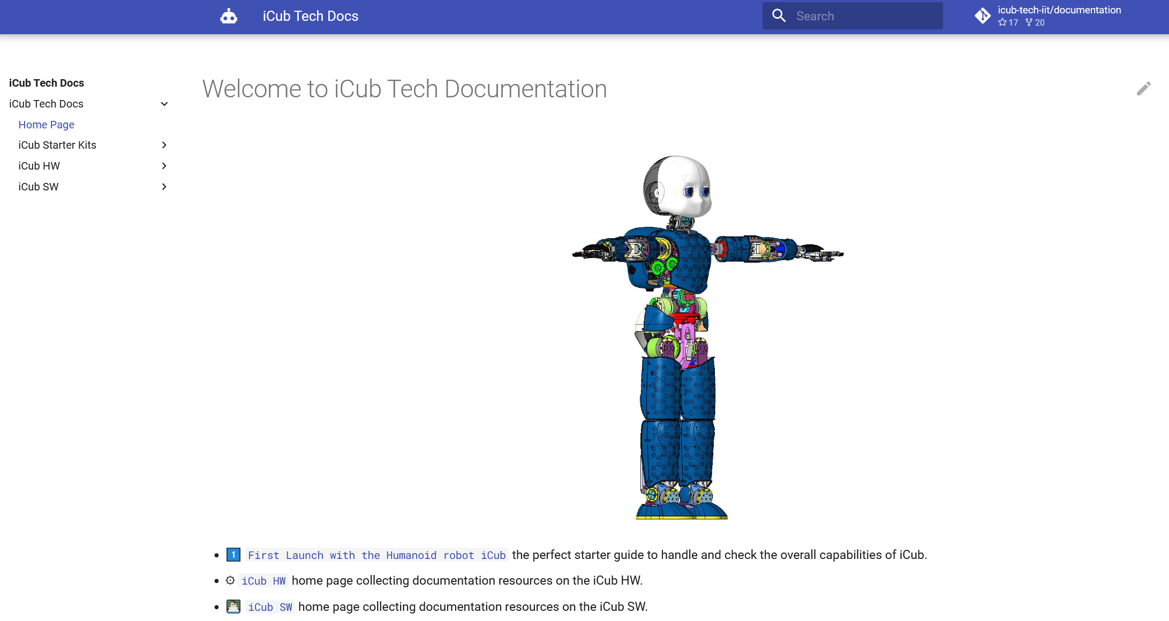
iCub Tech Docs
Where to find all these things…?
#1
https://icub-tech-iit.github.io/documentation/
The leading reference guide for both software and hardware
Notes:
iCub tech docs is the main guide for both hardware and software. Just googling icub tech docs you can find it, or follow the link above.

Slide 17
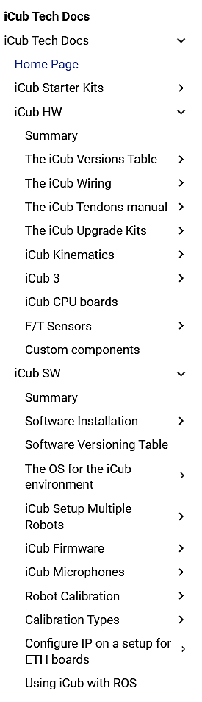
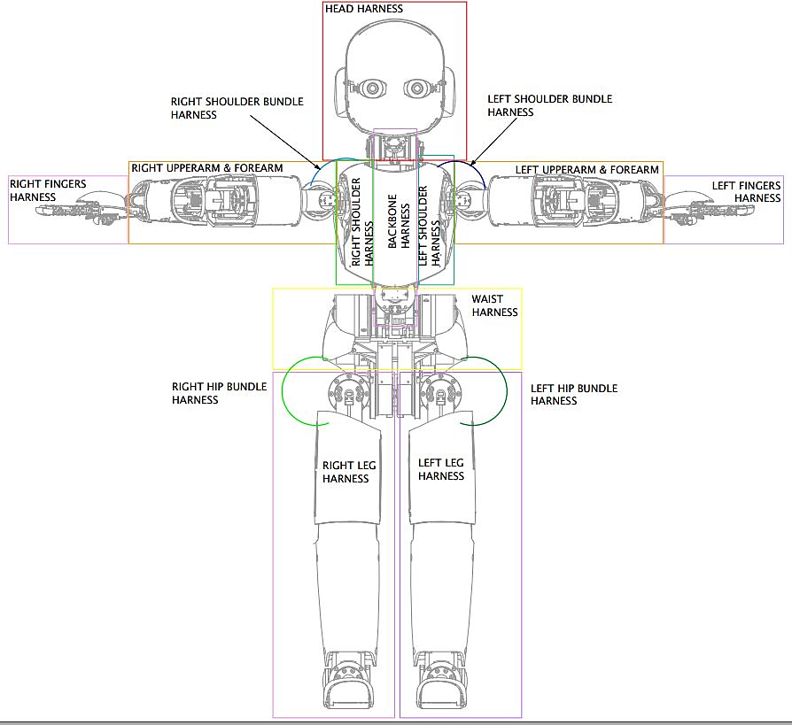
Ad hoc categories have been created for both software and hardware common issues
Sections
Doubts about the electrical connections?
Do I need to change a tendon?
How do I install the software?
Notes:
There are different sections. For example about electrical connections, how to change a tendon and a complete guide for software installation.

Slide 18
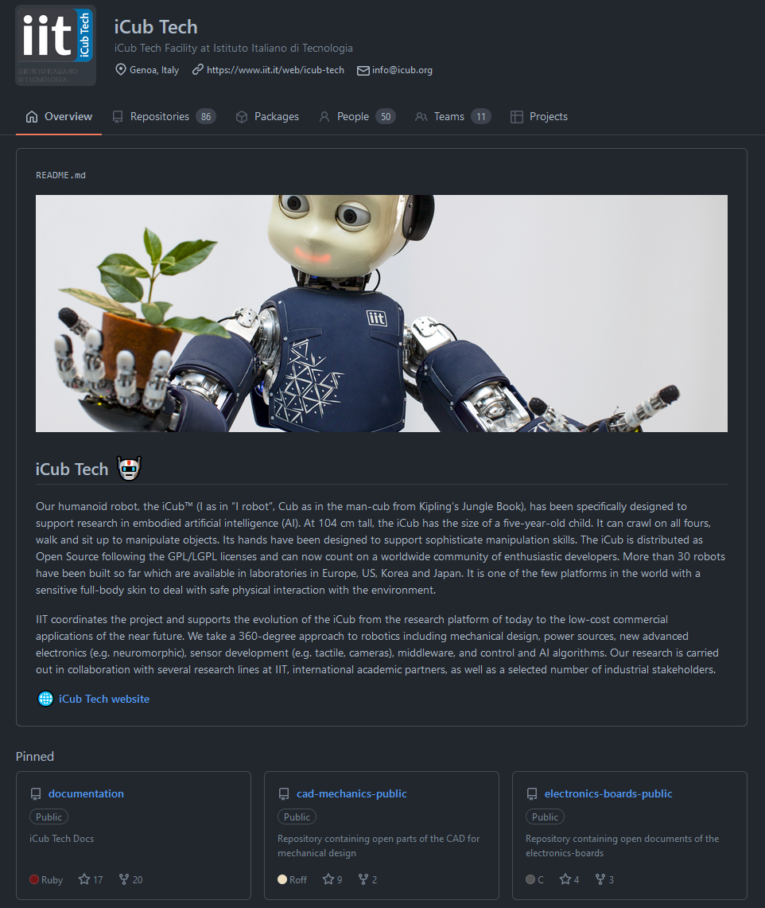


GitHub Repository
Where to find all these things…?
Here you can find all the repos with CAD and schematics, as well as the icub-tech-support where you can ask our technicians for help!
#2
https://github.com/icub-tech-iit
Notes:
An other place is the icub-tech-iit repository hosted on github where you can find a lot of source code and CAD/Schematics repo.
Please, if you need support (or just you feel alone) you can contact us by opening a ticket within the icub-tech-support repository.
Our aim is to creare a capillary support network for all the robots.

Slide 19

UNDERSTAND
It's not enough to just fix...
FIX
We want our little robot to be fit all the time!
PREVENT
Continuously improve the system to avoid future issues
Notes:
In order to conclude, I will recall our starting point.
1.Understand, because is not enough to just fix.
2.Fix, because is not enough to just understand
3. And prevent, to improve continuosly the system.

Slide 20
Any questions?
THANK YOU
Notes:
Thank you so much for the attention and if you have any question we are here for you!

